Slide 1
ILLUMINATION MODEL

Slide 2
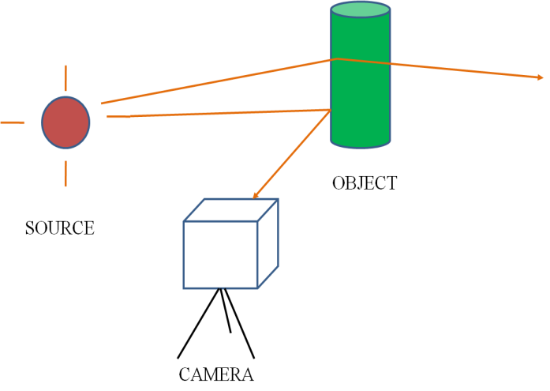
ILLUMINATION MODEL
/SHADING MODEL
To calculate the intensity of light at a given point

Slide 3
3D SCENE
MODEL & POSITION OBJECT
DETECT VISUAL SURFACE
GET SHADING MODEL

Slide 4
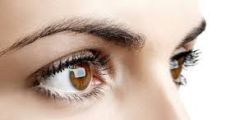
FACTORS BEHIND ILLUMINATION MODEL
1. LIGHT SOURCE
The objects that emits light (e.g. The sun, a light bulb)
LIGHT REFLECTING SOURCE
SOURCE

Slide 5
Point light source
A light source with small dimension compared to is approximated as point source
e.g. The Sun
Distributed light source
A light source with large dimension compared to is approximated as distributed source
e.g. Florescent light

Slide 6
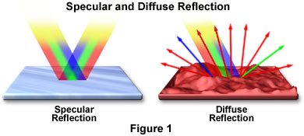
PERCENTAGE OF LIGHT FALL ON AN OBJECT
3. PROPERTIES OF SURFACE
Reflection………………Shiny, Dull
Absorption……………..Surface colour
Refraction……………...Transparent, Opaque
4. TYPES OF REFLECTION
Specular………..
Diffuse………
5. PROPERTIES OF MEDIUM
Uniform…………Light rays are not deviated
Non uniform…….Light rays are deviated

Slide 7
ANALYSIS OF ILLUMINATION
Reflected Light
I_{refl}
From Light emitting source
From Light reflecting source
I_{amb_diff}
Specular Reflection
Diffuse Reflection
I_{spec}
I_{diff}

Slide 8
N
R
L
V

Slide 9
N
L

Slide 11
INTENSITY ATTENUATION
‘d’ is the distance the light has travelled.

Slide 12
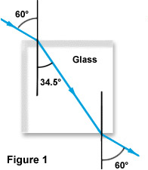
TRANSPERANCY

Slide 13
COLOUR CONSIDERATION
k_{a} | [Rk_{a}, Gk_{a},Bk_{a}]
k_{d} | [Rk_{d}, Gk_{d},Bk_{d}]
k_{s} | [Rk_{s}, Gk_{s},Bk_{s}]
I_{L} | [RI_{L}, GI_{L},BI_{L}]
I_{a} | [RI_{a}, GI_{a},BI_{a}]

Slide 14
END OF CHAPTER

